Slide 1
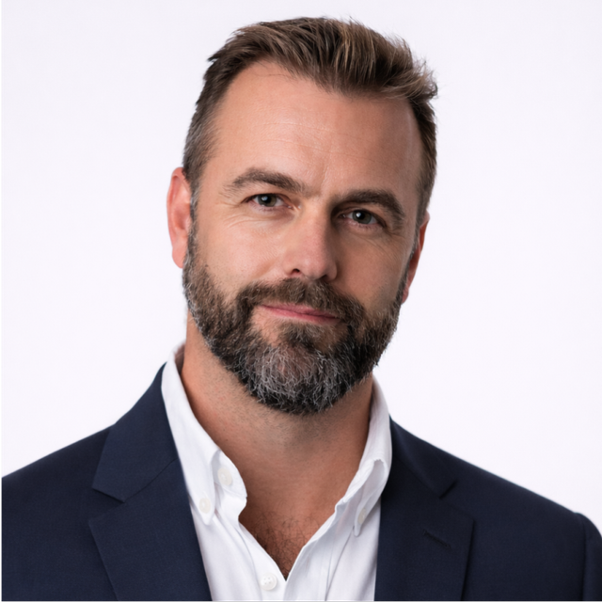
Richard Hardiman
Founder, RanMarine Technology
Speaker

Slide 2
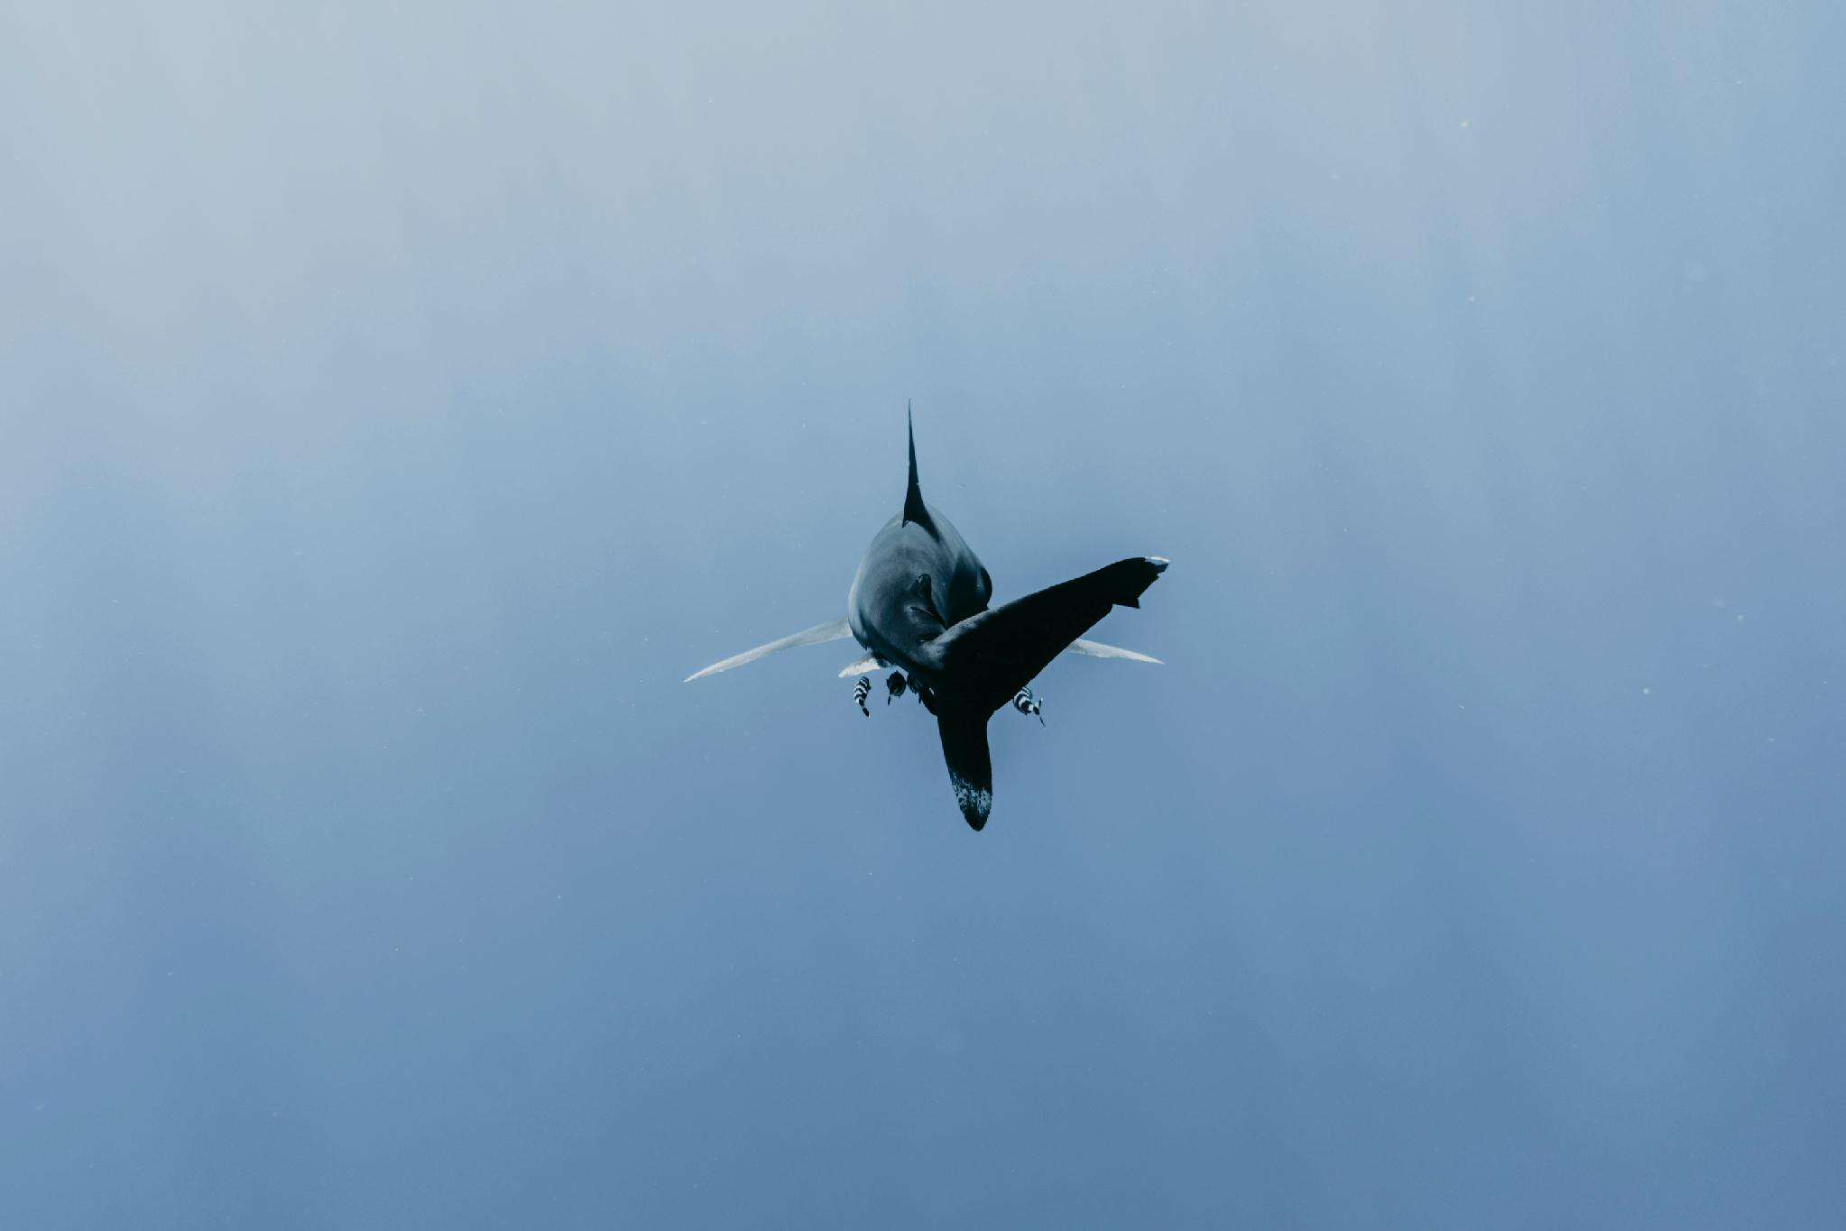
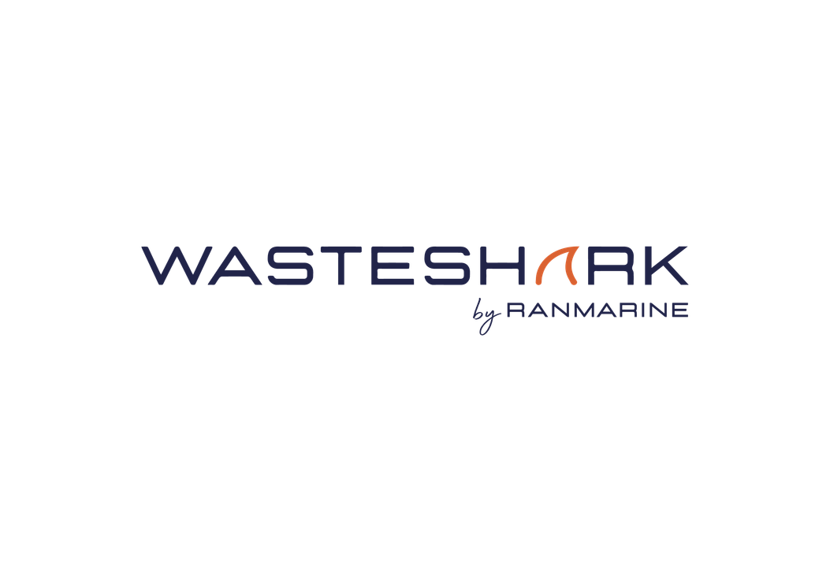
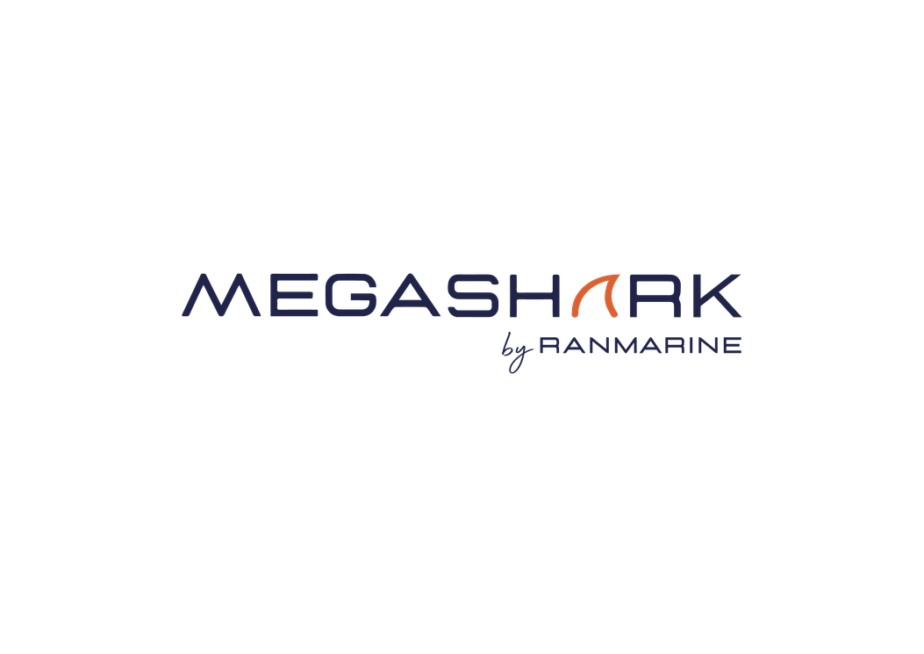
Autonomous solutions for Cleaner Waterways, Ports and Oceans
Richard Hardiman (Founder & President, RanMarine Technology)

Slide 3
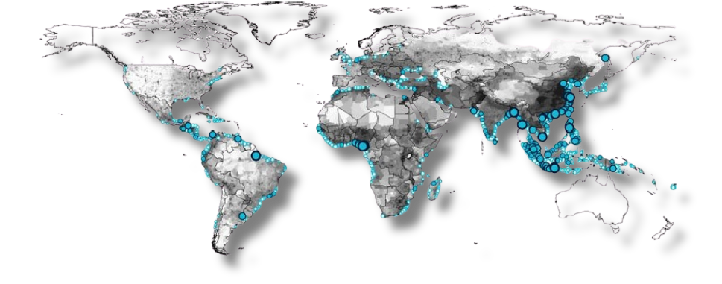
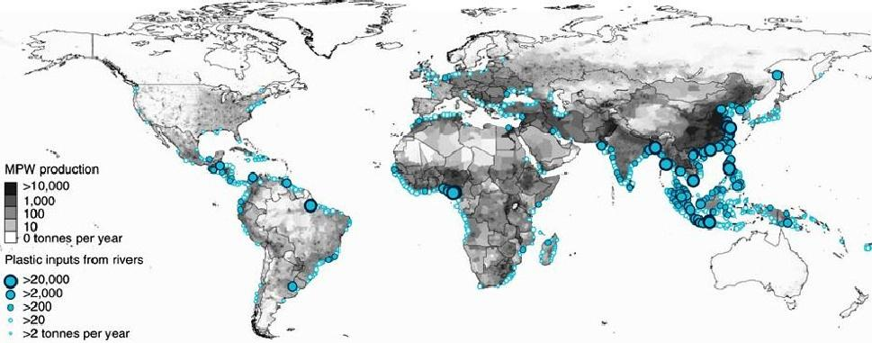
The Frontier Challenge: Intercepting Debris at the Source
LEBRETON 2017 - Mass of river plastic flowing into oceans in tonnes per year. River contributions are derived from individual watershed characteristics such as population density, mismanaged plastic waste (MPW) production per country and monthly averaged runoff. The model is calibrated against river plastic concentration measurements from Europe, Asia, North and South America.

Slide 4
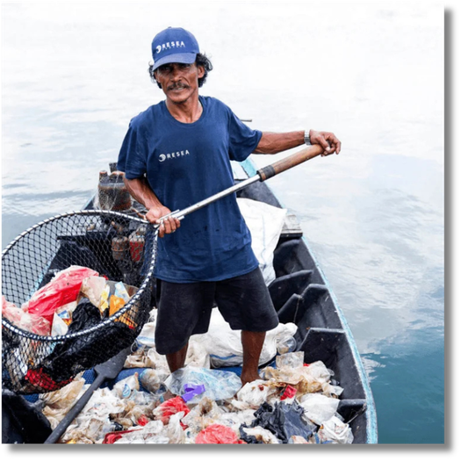
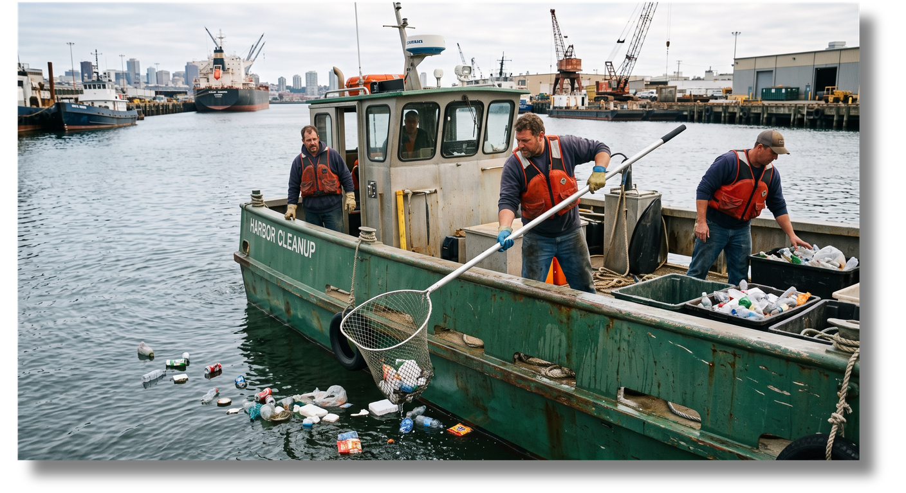
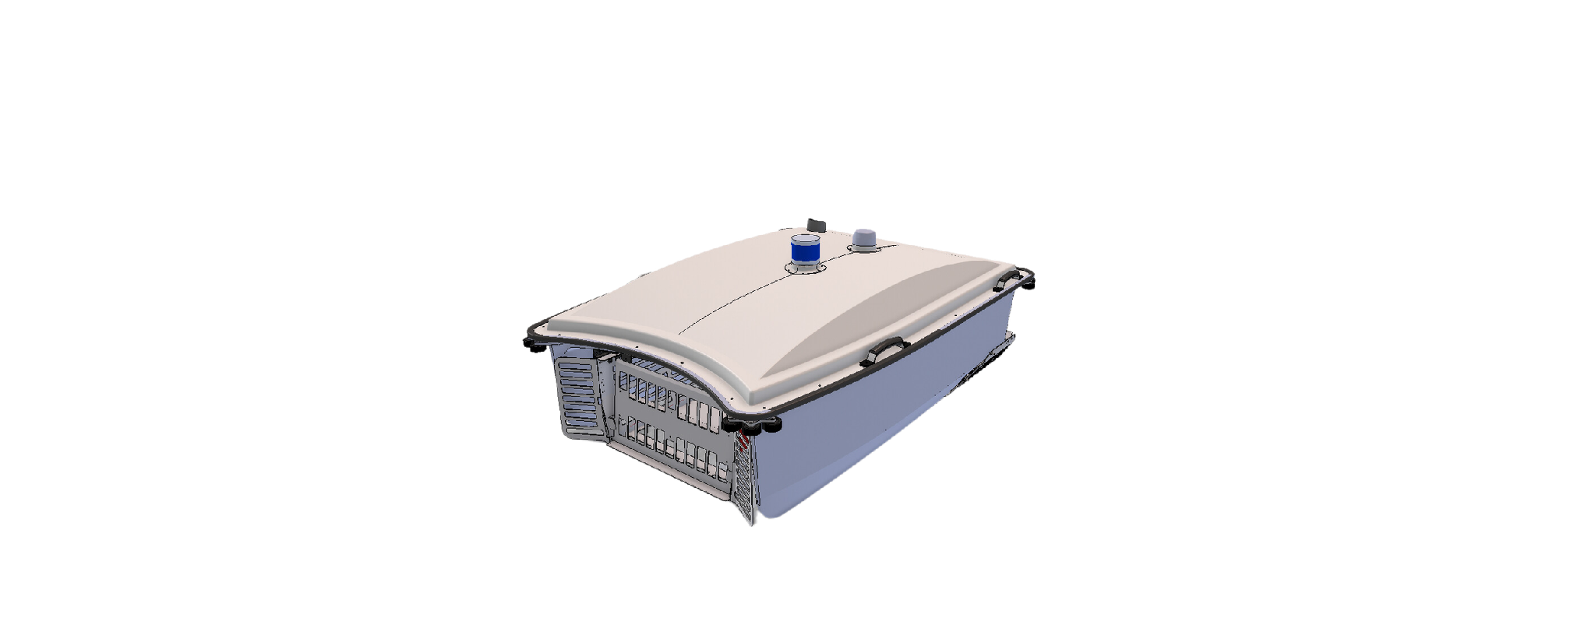
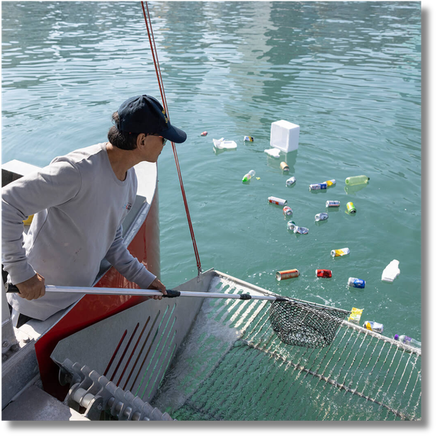
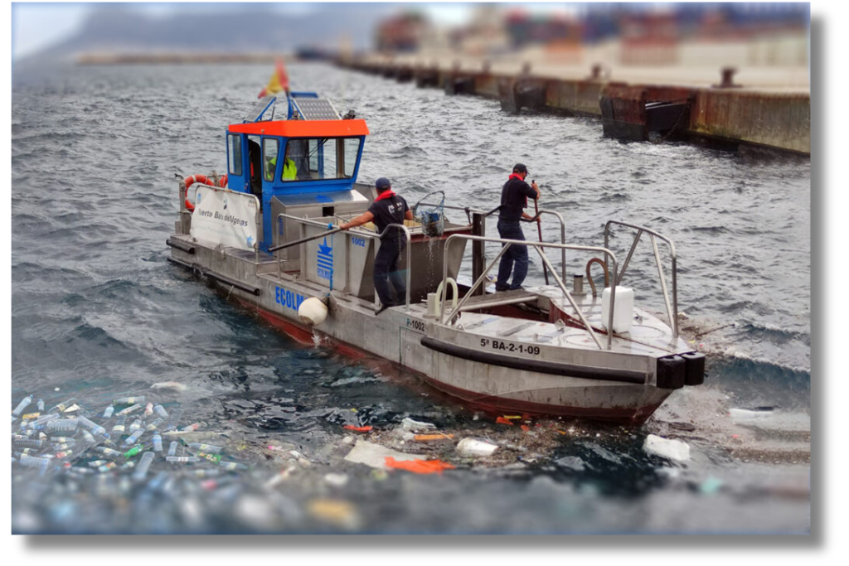
The Human Challenge: Old Methods against New Challenges
  High labor costs
  Safety and health hazards
  Limited coverage and speed
  Inconsistent detection
  Physical strain and fatigue
Robotic ASV’s
Autonomous or Remote-Control
25%-80% reduction in annual costs
Ability to work 24/7
Zero Emissions and minimal noise
No workers on water

Slide 5
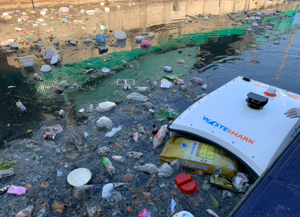
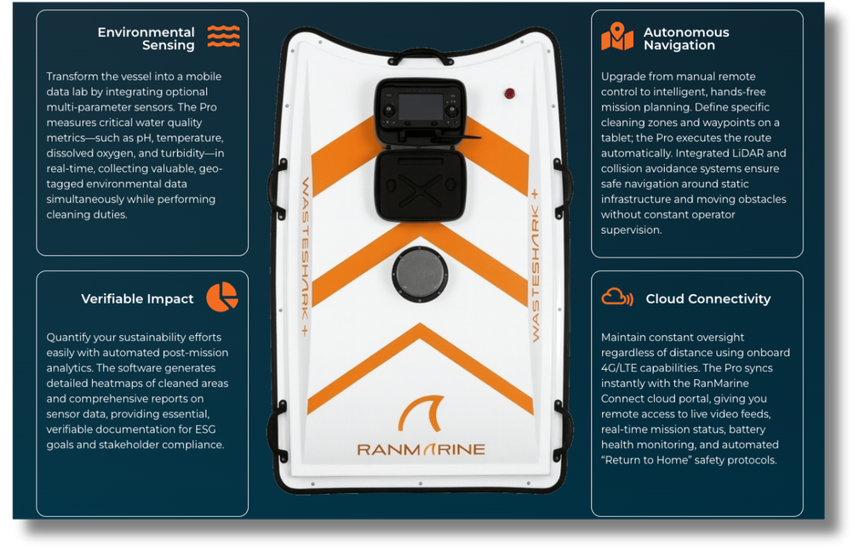
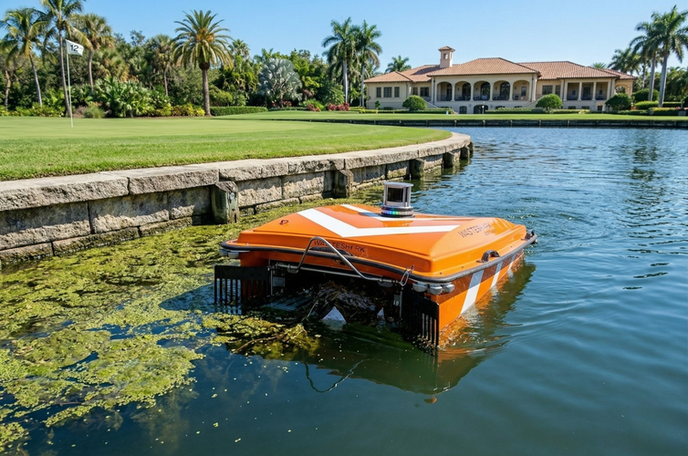
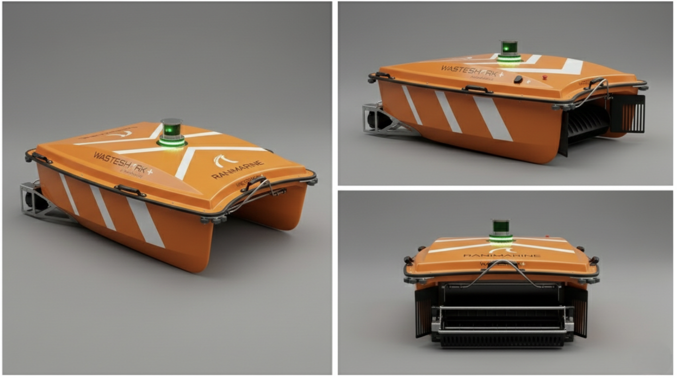
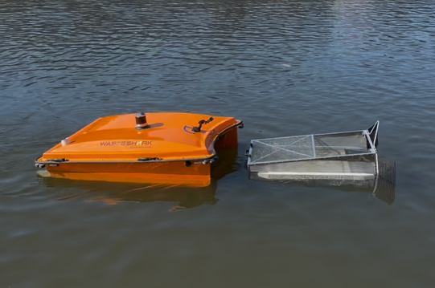
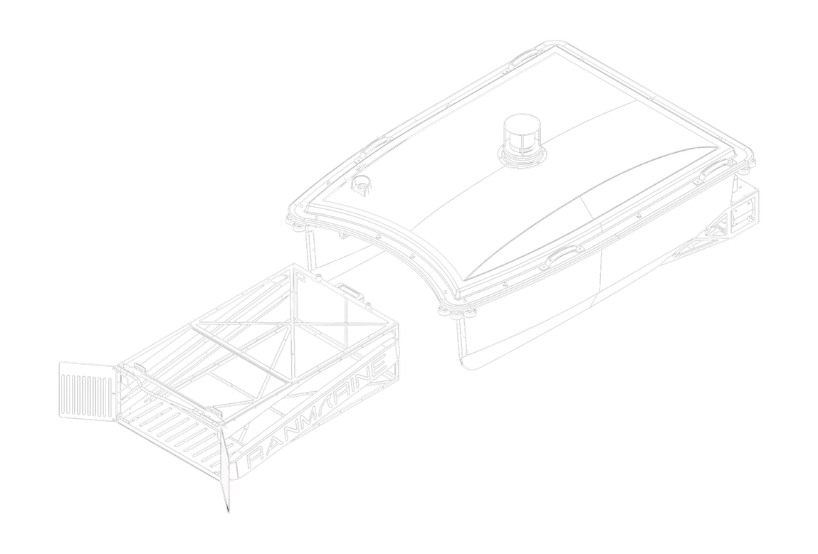
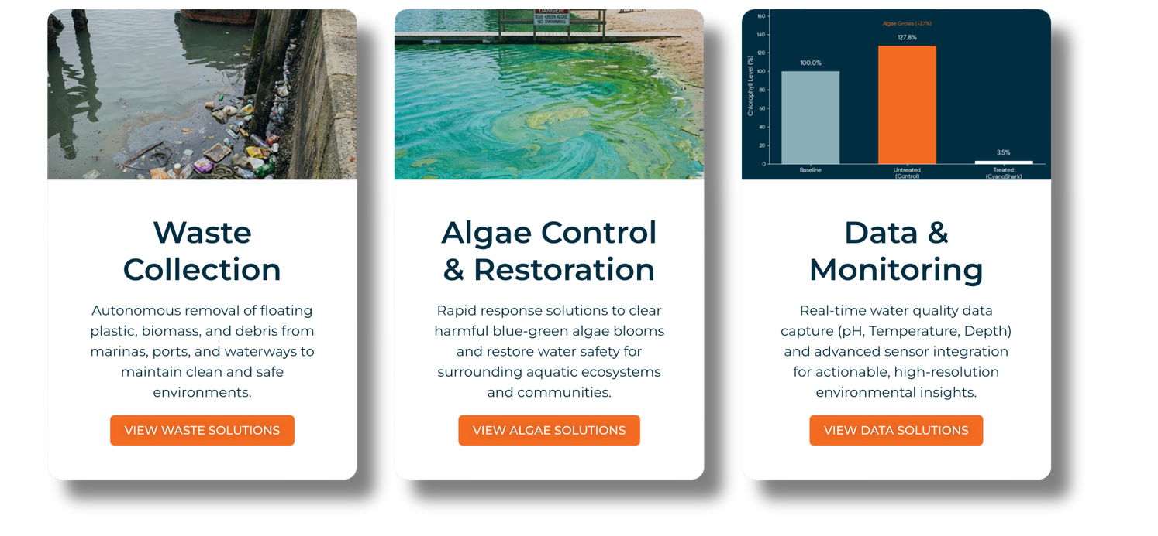
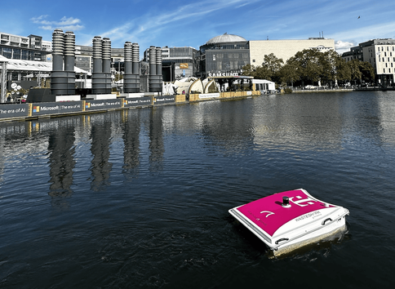
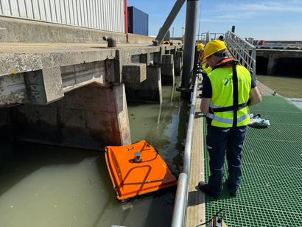
150+ ASV’s Deployed Globally
ASVs in Action: Practical Deployments & Operations
  24/7 Operational Capacity
  Real-time Environmental Data Gathering
  Targeted and Predictive Cleaning
  Scalable Fleet Efficiency
  Zero-Emission, Low-Noise Operation

Slide 6
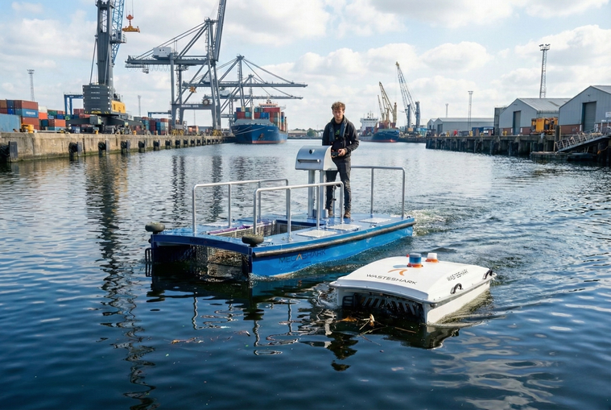
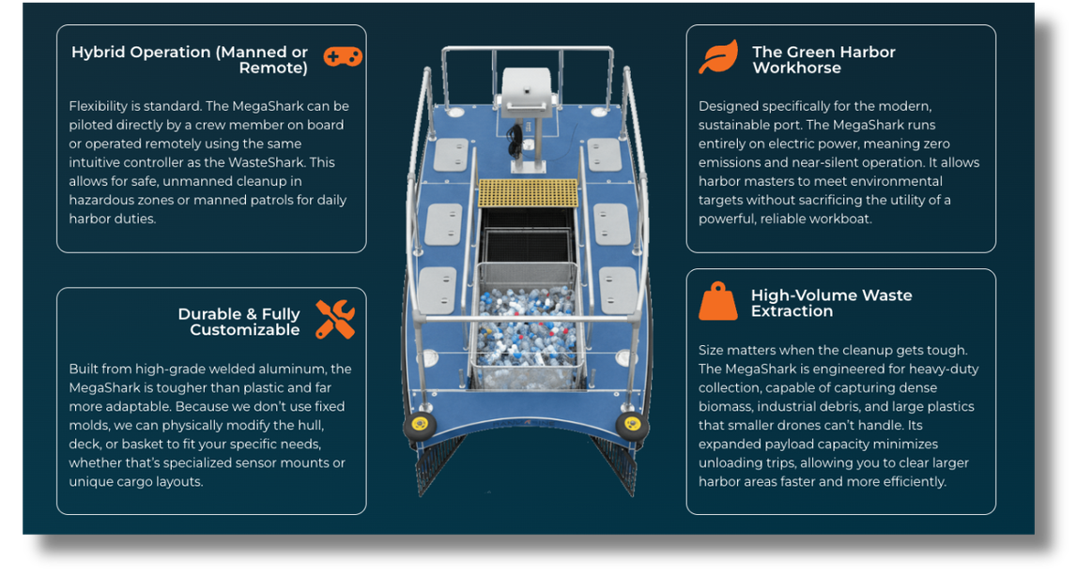
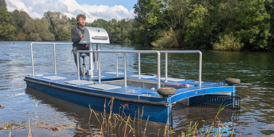
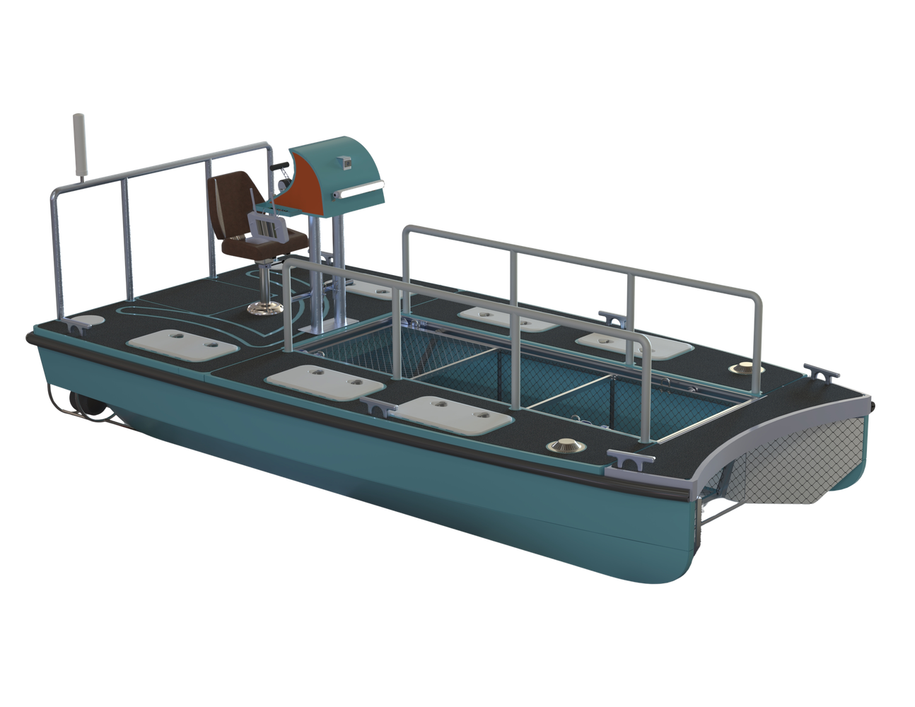
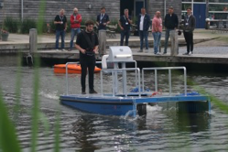
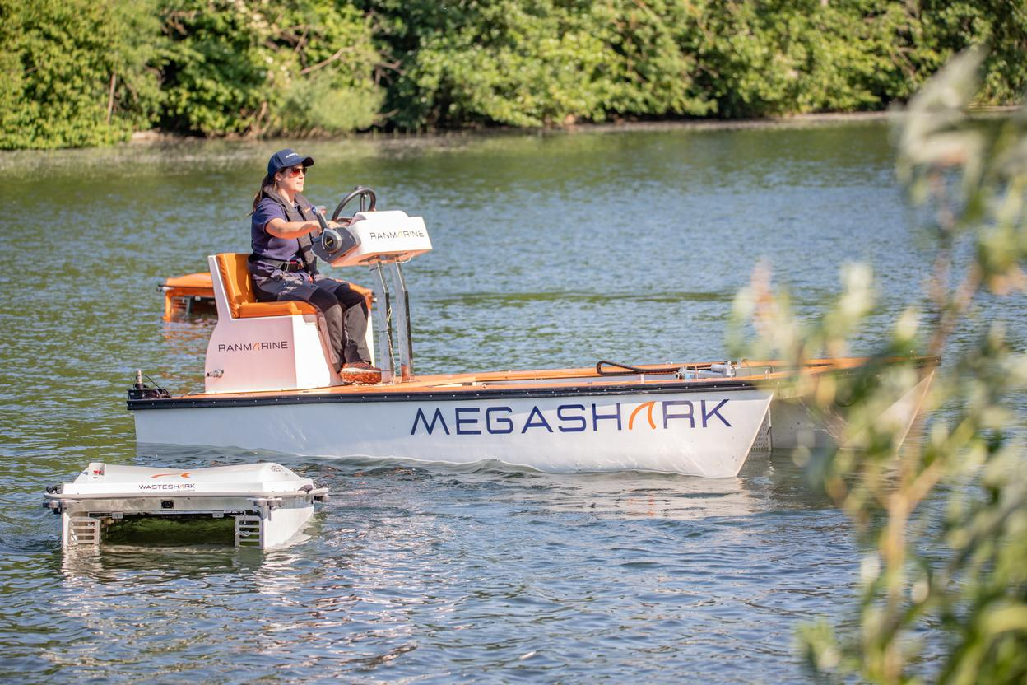
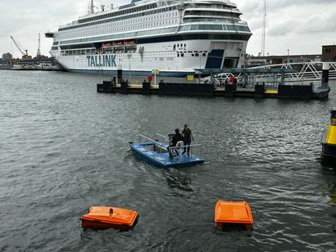
ASVs in Action: Practical Deployments & Operations
The MegaShark is an industrial-grade Autonomous Surface Vessel (ASV) developed by RanMarine Technology to tackle heavy-duty harbor pollution. The electric vessel scoops up plastics, floating debris, and dense biomass directly into its large front intake, holding up to 880 liters (440 kg) of waste per trip. Built with a rugged aluminum hull and twin silent electric thrusters, it delivers up to 12 hours of zero-emission operation and can be steered directly onboard or piloted remotely in hazardous zones.

Slide 7
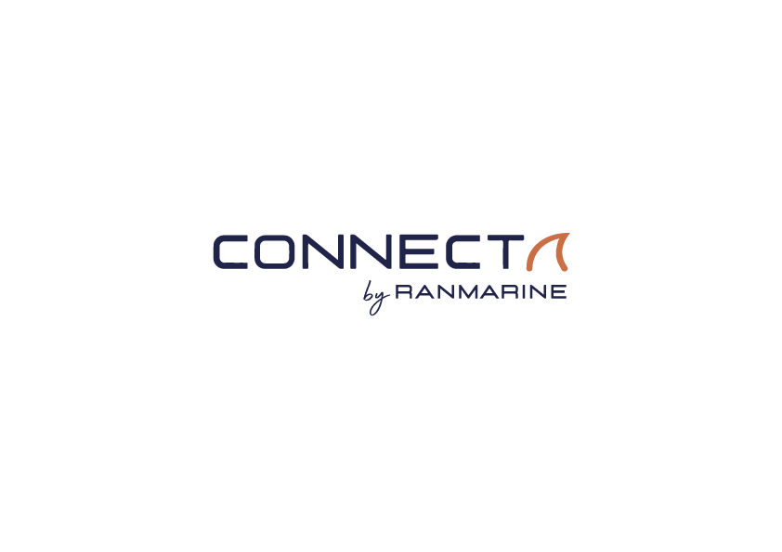
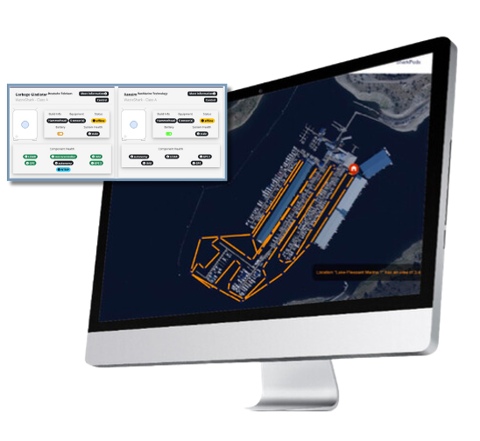
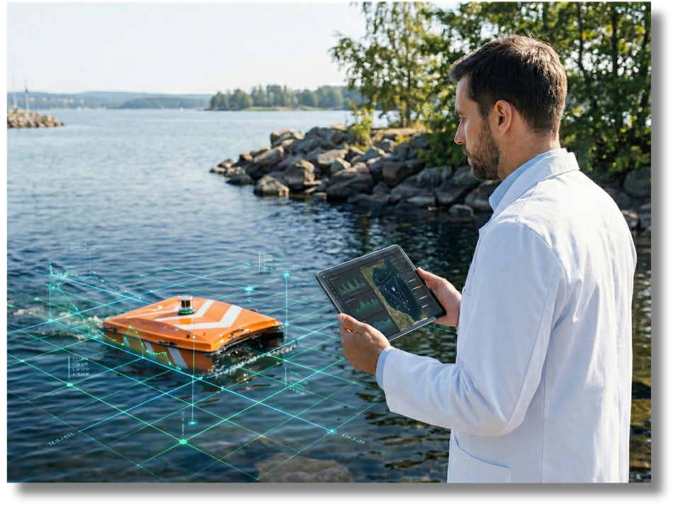
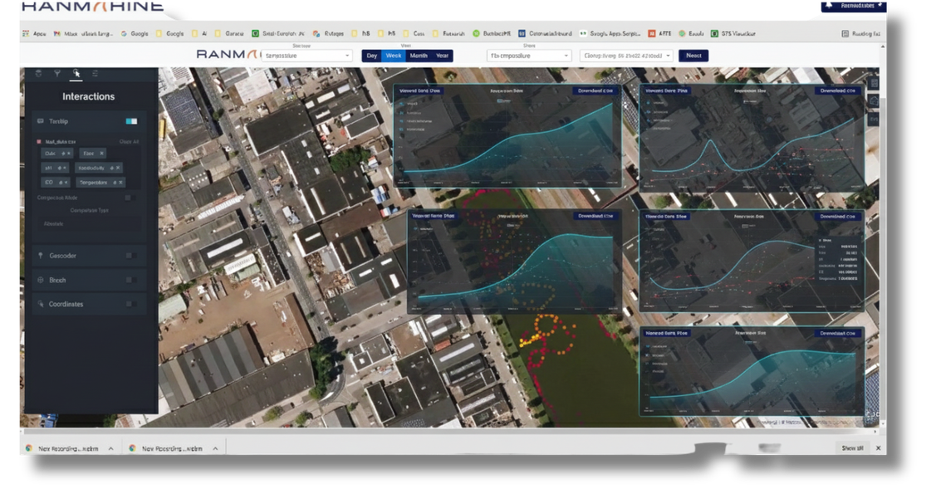
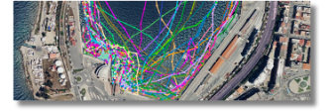
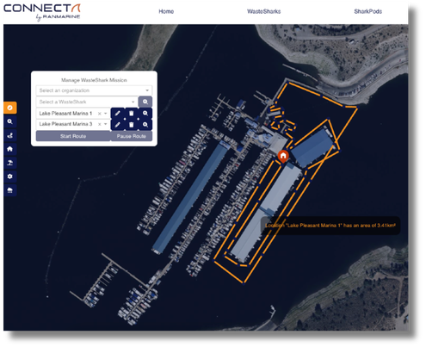
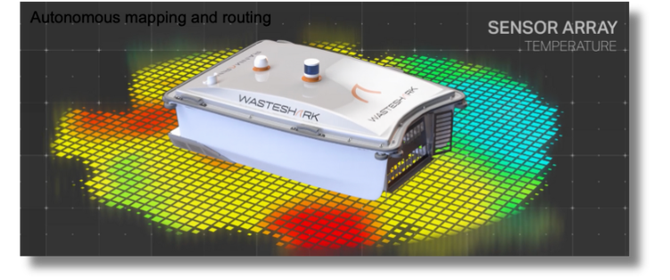
From Trash & Debris to Intelligence: Data-Driven Governance
  Targeted and predictive cleanup
  Continuous environmental compliance
  Enhanced navigational situational awareness
  safely around crowded berths without human error.
  Optimized fleet productivity and routing
  Proactive hazard and spill detection

Slide 8



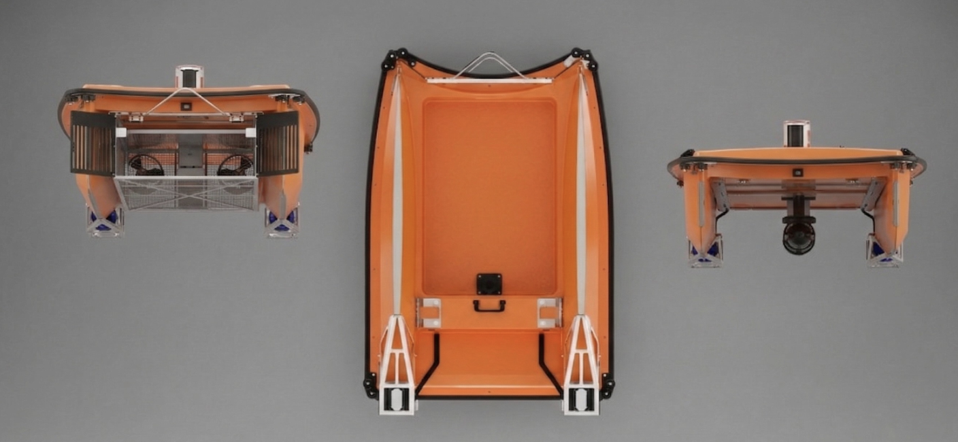
Water Quality and Bathy
HAB’s & CYANOBACTERIA
MULTI
Platform Solution
RanMarine ASV’s are capable of carrying multiple water quality sensors and we are now in the final stages of development with in-situ water samples on water in cooperation with Rutgers University, USA. We envisage a fully autonomous data-only ASV with the ability to collect data and samples.
RanMarine recently started activity on Blue Green Algae Mitigation in partnership with Eget Liber USA. The company recently won a pilot with the Northern Ireland Government to test ASV technology in the removal of HAB’s (Cyanobacteria).
RECOVERY SOLUTIONS
AQUACULTURE
Our platform that has been requested is a search and rescue ASV capable of remotely locating drowning victims via surface investigation. RanMarine’s WasteShark is a reliable platform for mounting multibeam sonars and other sensors that can perform remote tasks for law enforcement.
Using our existing platforms with the requisite sensors, our ASV’s can be deployed to monitor aquaculture ponds, combat sea lice infestation, show fish stock, and ultimately be used to monitor environment health and aid in predicting stock yields.

Slide 9
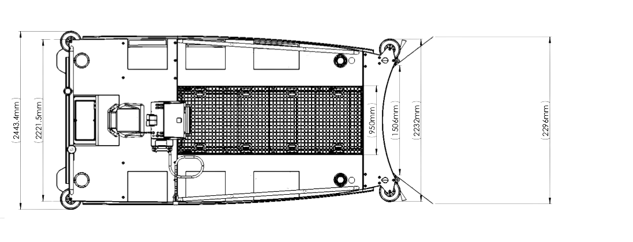
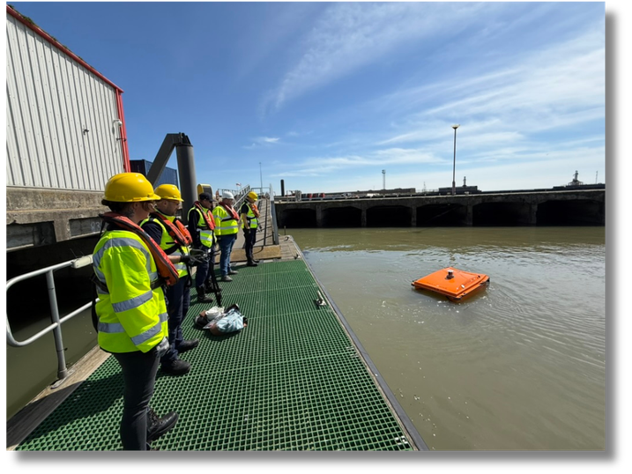
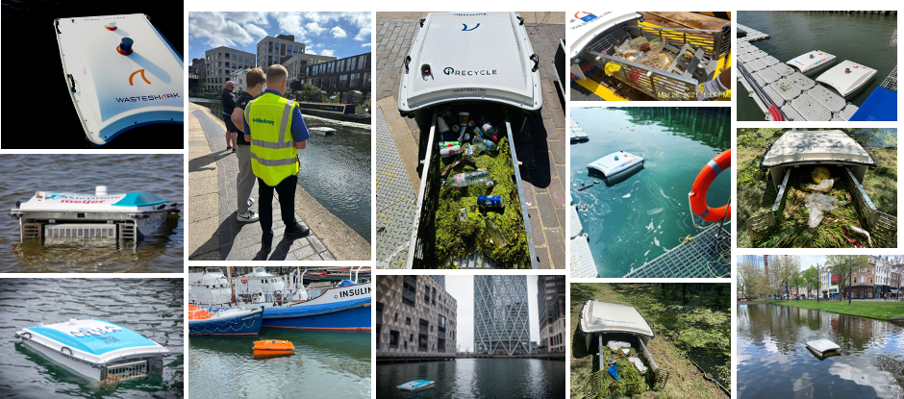
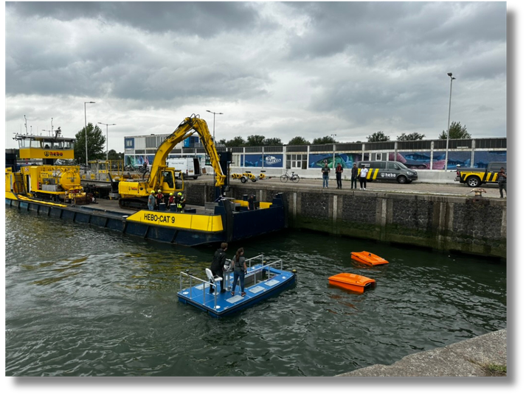
37 Territories Worldwide and Growing

Slide 10
Thank You

