Slide 1
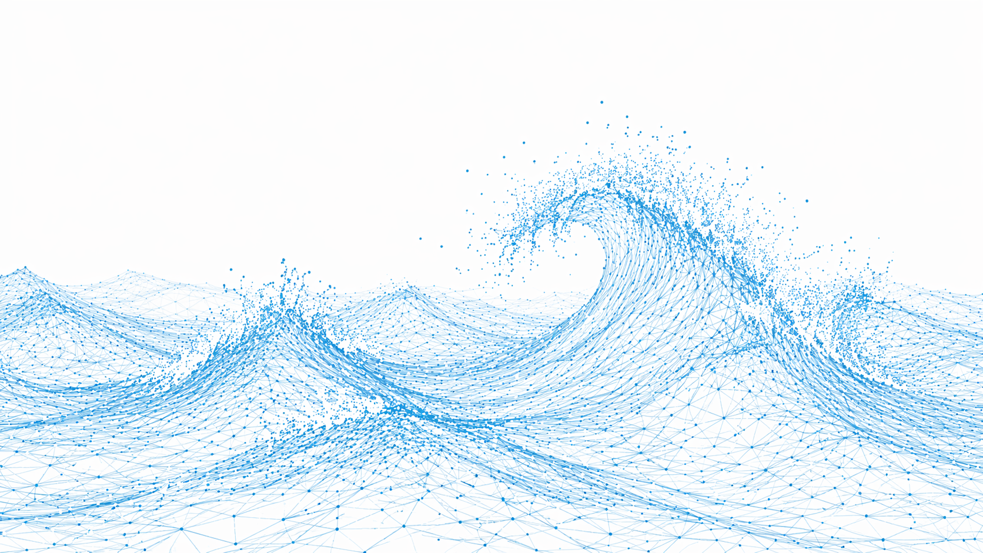

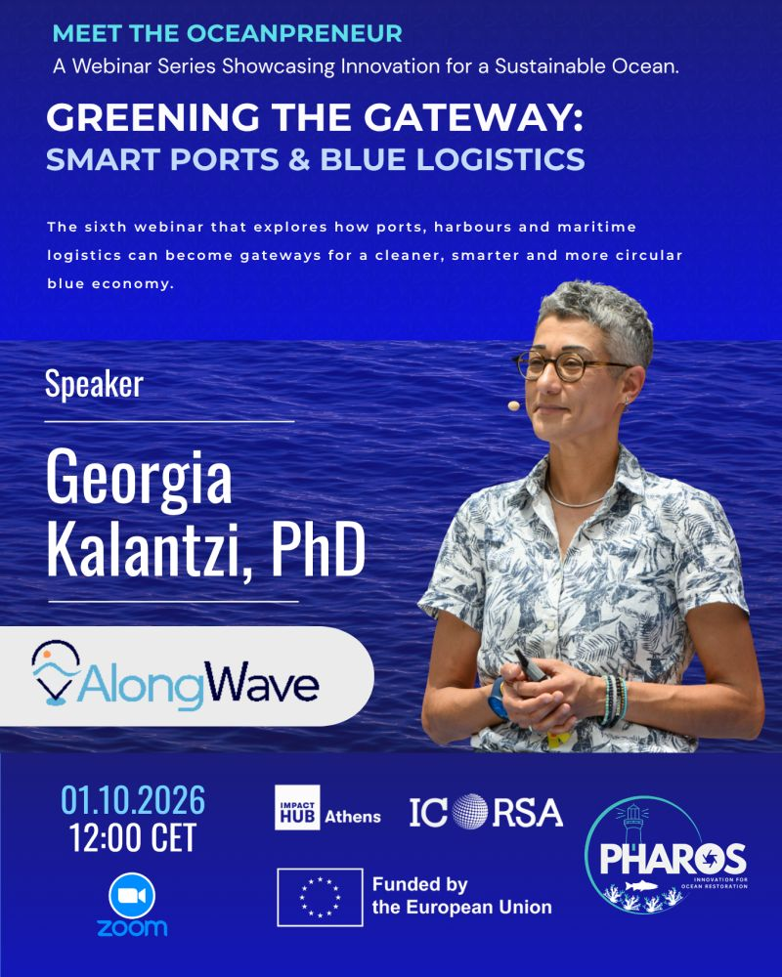
The ocean is still under-observed.
The challenge is to build a better representation of the ocean state globally and turn it into insights users at sea can trust and use.
Marine-weather intelligence
for confident decisions at sea
October 2026
© 2026 AlongRoute Data IKE | Trading as AlongWave. All rights reserved | Team@AlongWave.com

Slide 2


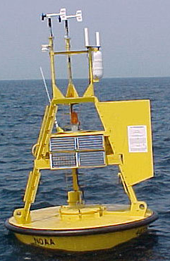
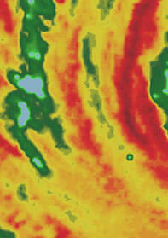
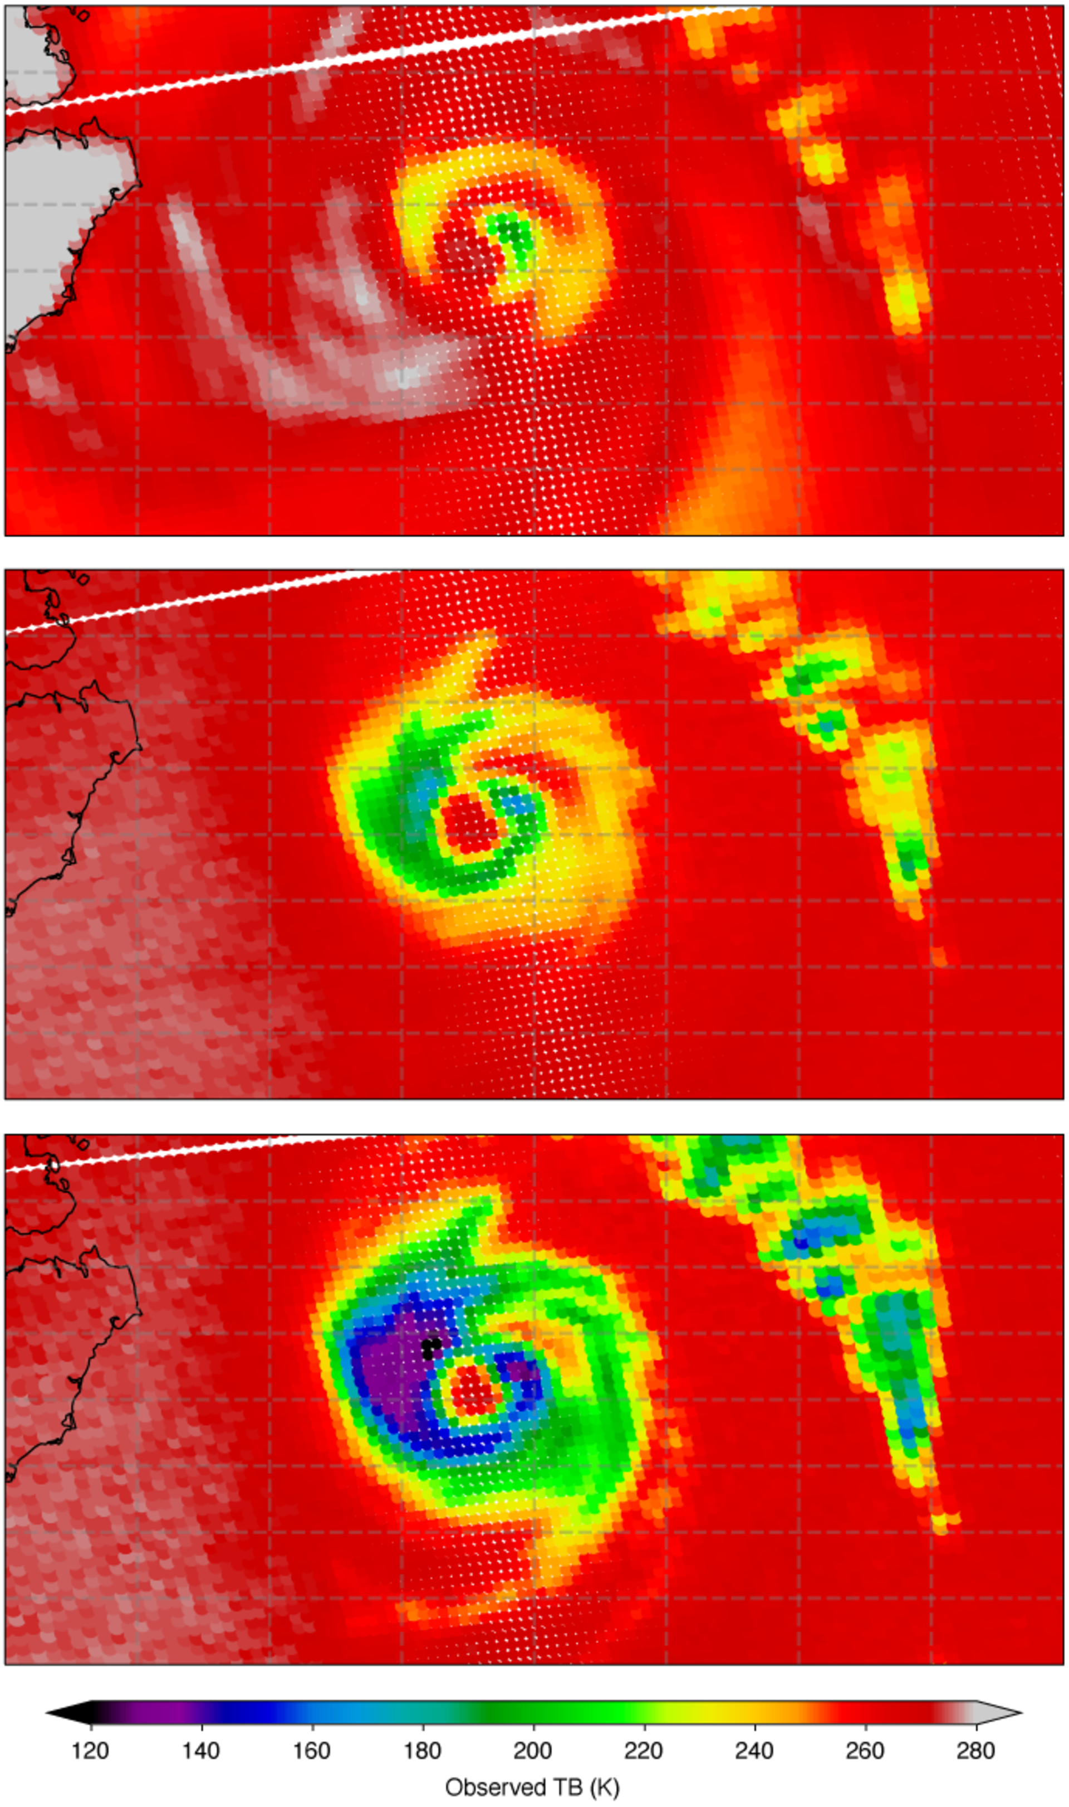
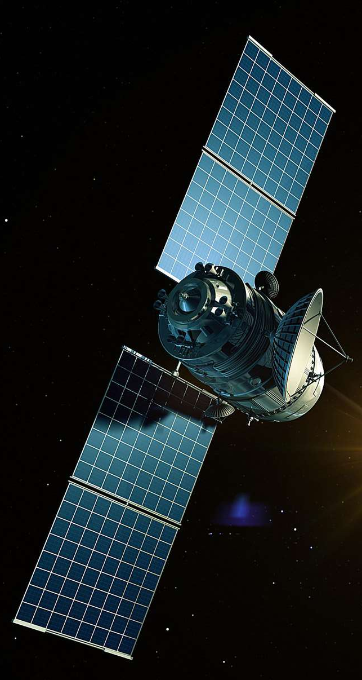
EVERY PREDICTION STARTS WITH THE OCEAN STATE
Sparse and incomplete observations create uncertainty before the forecast even begins.
BUOYS
valuable but sparse
HISTORICAL OCEAN STATE
the training baseline for every model
NUM. MODELS
full coverage but approximations
CURRENT OCEAN STATE
the starting point for every prediction
SATELLITES
good coverage but partial view
REANALYSIS
model-based approximations
UNCERTAINTY PROPAGATES DOWNSTREAM
forecast → route → performance → risk
© 2026 AlongRoute Data IKE
Trading as AlongWave. All rights reserved Team@AlongWave.com

Slide 3
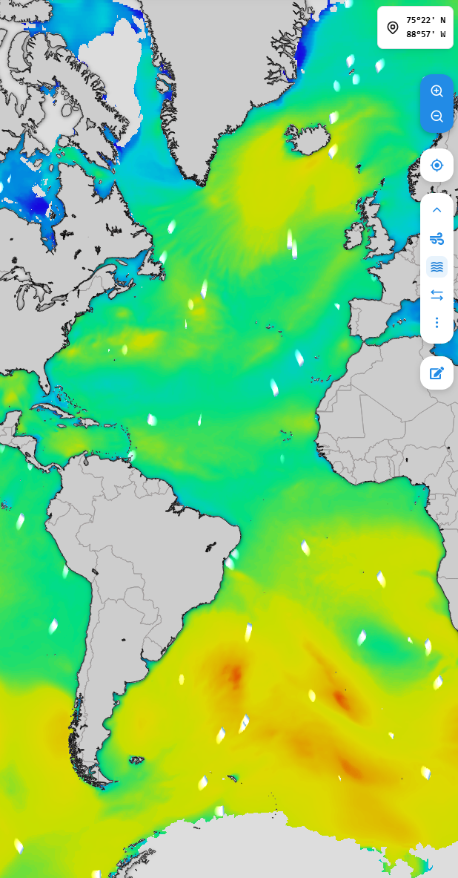


OBSERVATION-INFORMED | MULTI-SOURCE
Our edge is the combined methodology and system; not AI alone.
01
Observe
02
Reconstruct
03
Train & initialize
04
Forecast
05
Validate
EO,
buoys,
indirect in-situ,
model baselines,
reanalysis.
Best possible ocean-state global depiction.
Learn errors,
patterns and
physical relevance.
Metocean data and products operationally delivered.
Compare,
benchmark,
calibrate,
repeat.
AI-Fused observations
AI-Assimilation
Operations-ready products
Ocean Conditions Reconstruction Layer TM
Physics-aware AI forecasting
More accurate forecasts and historical data
explore our data
© 2026 AlongRoute Data IKE
Trading as AlongWave. All rights reserved Team@AlongWave.com

Slide 4

ONE ENGINE | THREE TIME-SCALES
Operational decisions, evidence and learning, all from the same marine-weather intelligence engine.
CONFIDENCE + DEFENSIBILITY
RECONSTRUCTED PAST
Historical ocean state reconstructions.
What most likely happened.
DECISION MOMENT
Archived forecasts and provenance.
What information was available.
PREDICTED FUTURE
Global operational forecasts up to 15 days ahead.
© 2026 AlongRoute Data IKE
Trading as AlongWave. All rights reserved Team@AlongWave.com

Slide 5
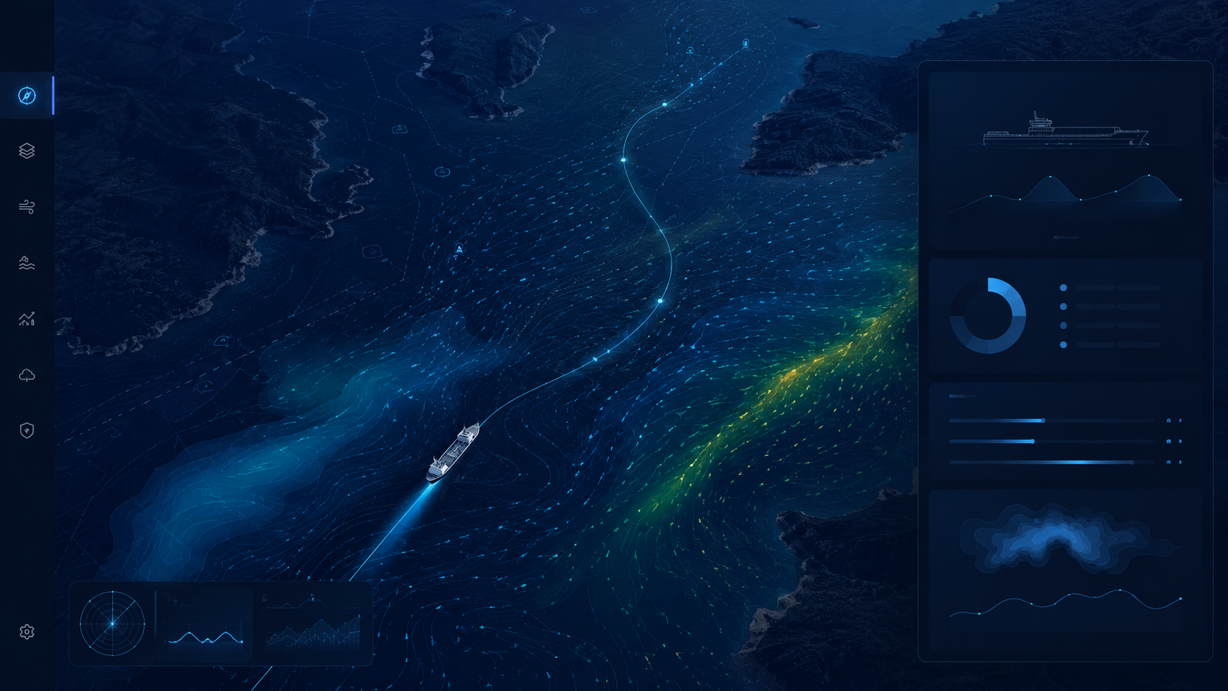
BUILT FOR B2B MARITIME WORKFLOWS
We work beneath existing products and scaling is straightforward.
Risk
Claims
Insurance
Automated maritime systems
Voyage optimization
Fleet performance
Offshore operations
ONE ENGINE | TRUSTED METOCEAN INTELLIGENCE FOR MANY APPLICATIONS
Waves, wind, currents and other critical metocean parameters.
One engine serves multiple workflows, users and integrations.
Scalable and transferable platform-ready model.
© 2026 AlongRoute Data IKE
Trading as AlongWave. All rights reserved Team@AlongWave.com

Slide 6


WHY THIS MATTERS FOR SMART PORTS
Connect metocean intelligence to the systems already in place.
OBSERVE
UNDERSTAND
PREDICT
ACT
REACT & PROACT
REASSESS
Metocean context for:
Vessel movements
Autonomous assets
SMART PORT LOOP
Pollution pathways
Environmental monitoring
Decision support tools
© 2026 AlongRoute Data IKE
Trading as AlongWave. All rights reserved Team@AlongWave.com

Slide 7
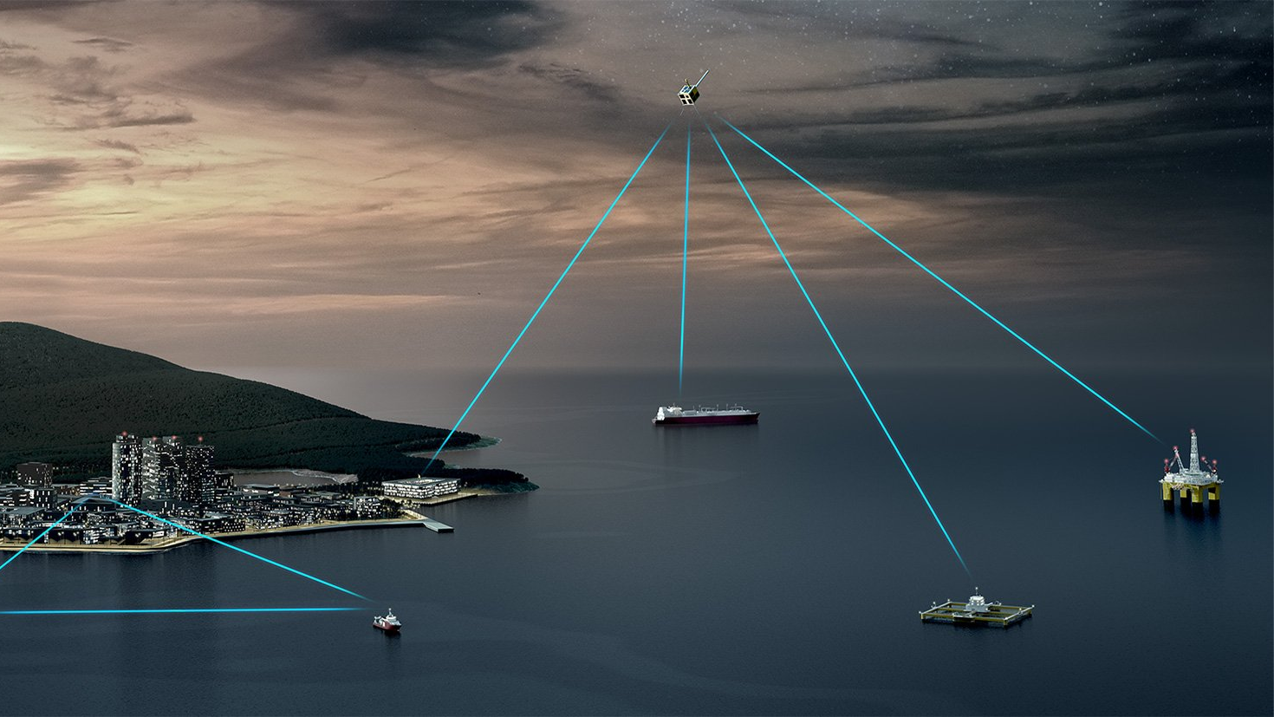

Marine-weather intelligence
for confident decisions at sea
alongwave.com
© 2026 AlongRoute Data IKE | Trading as AlongWave. All rights reserved | Team@AlongWave.com

